Slide 1
Discrete Mathematics BCSC0010
Module 1
Sets(Lecture3)

Slide 2
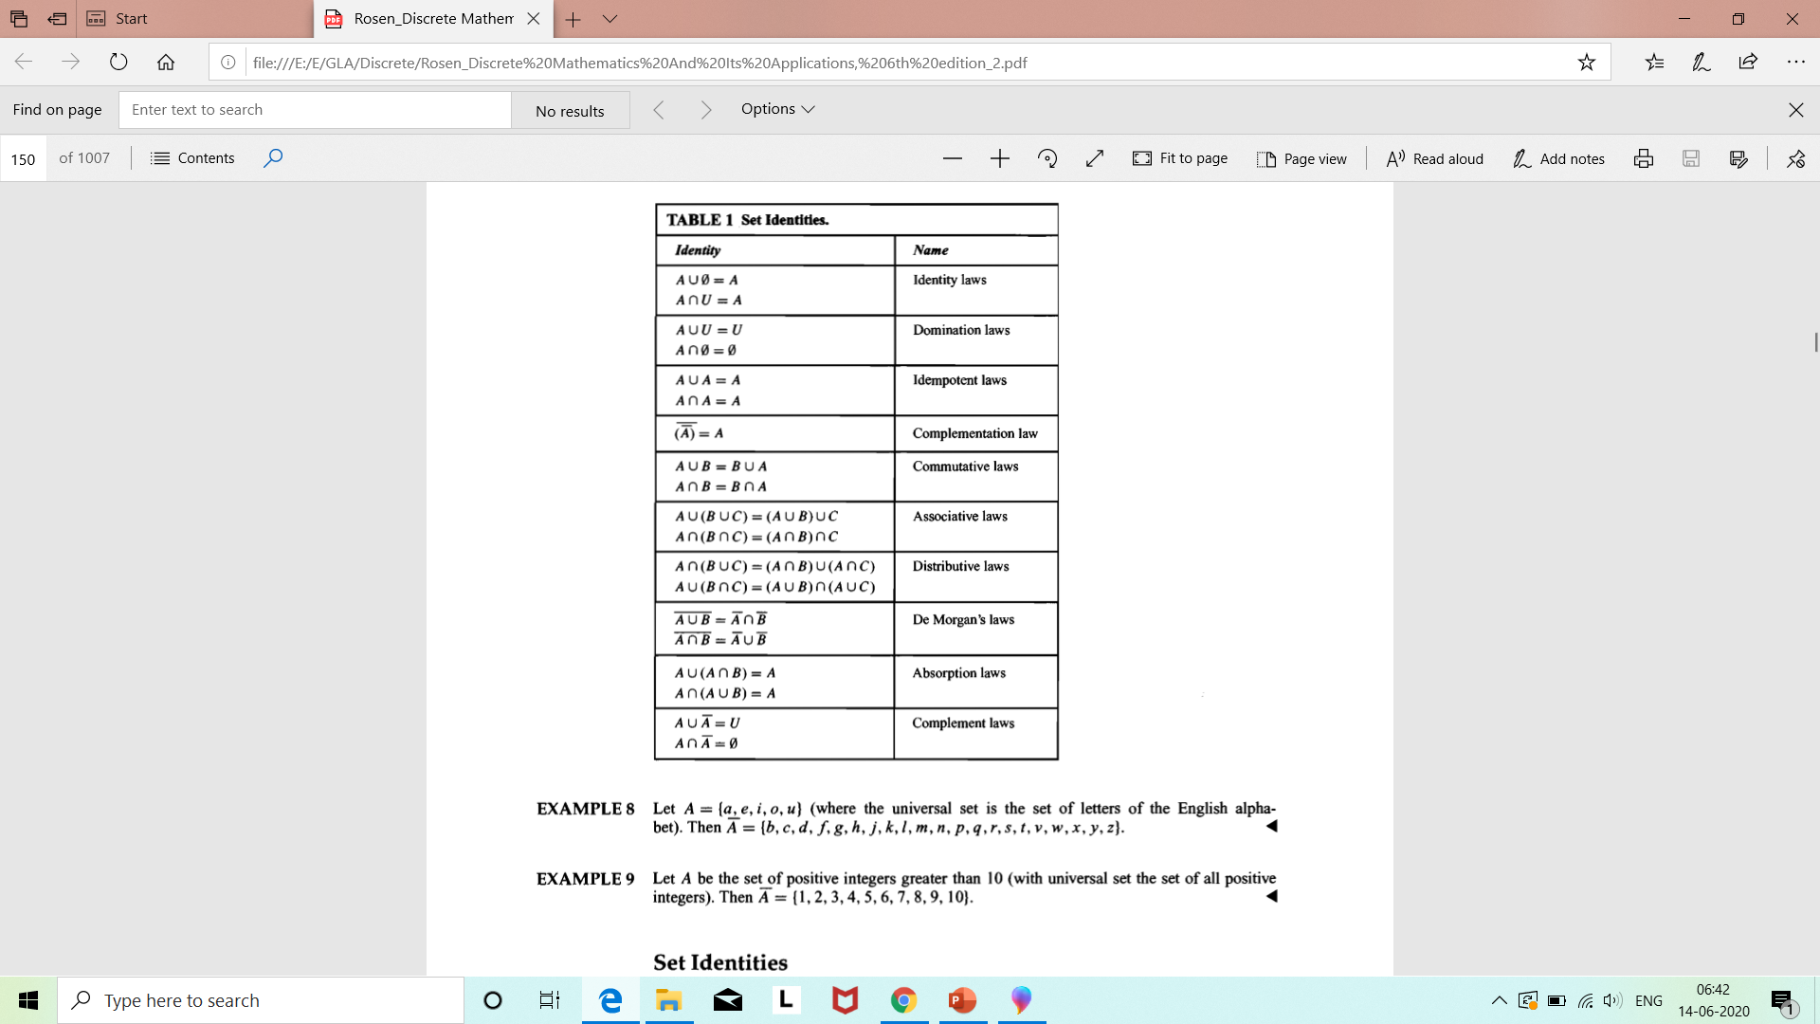
Set Identities

Slide 3
Methods to prove Set Equality
1. By Logical Equivalences
2. By Venn Diagram
3. By proving subsets of each other

Slide 4
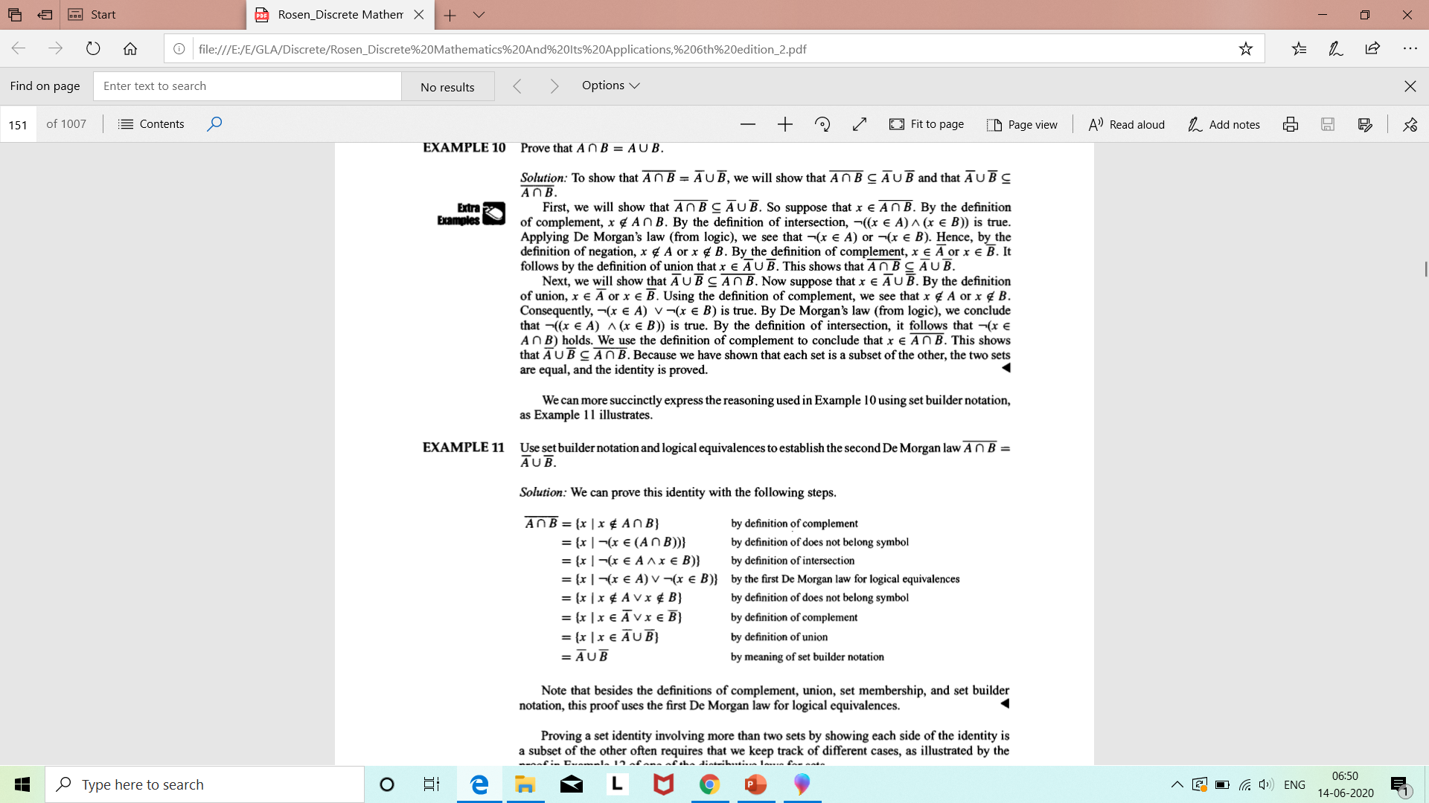
Example1 (By logical equivalences)

Slide 5
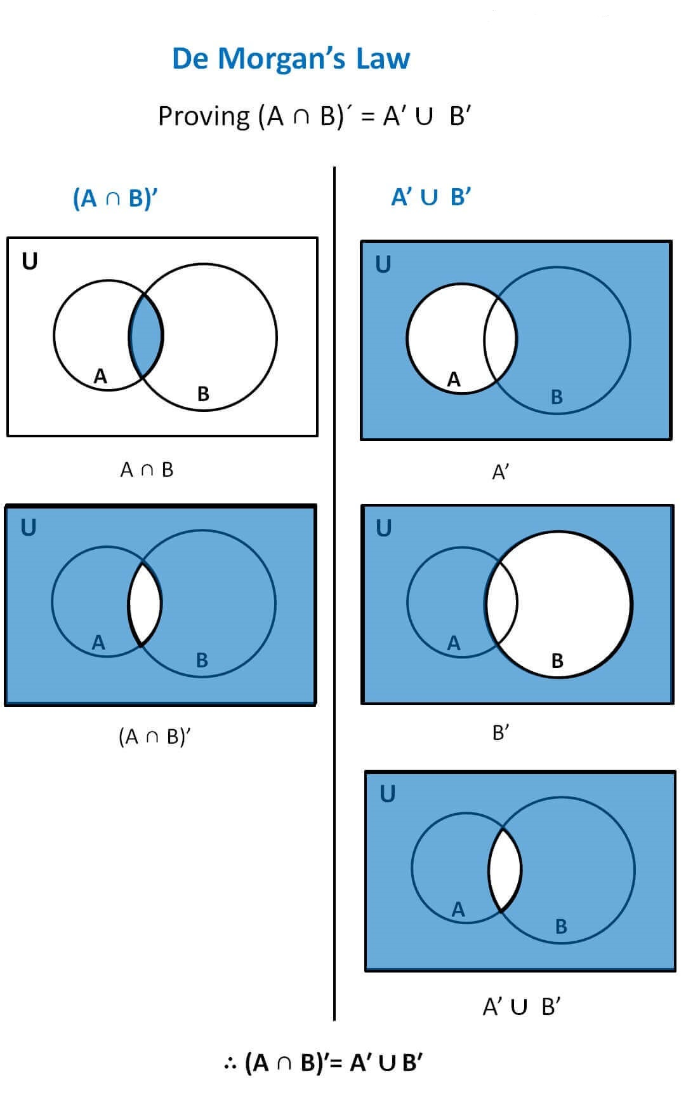
Example1 (By Venn Diagram)
Ref: https://www.teachoo.com/7038/1350/De-Morgans-Law/category/Complement-of-set/

Slide 6
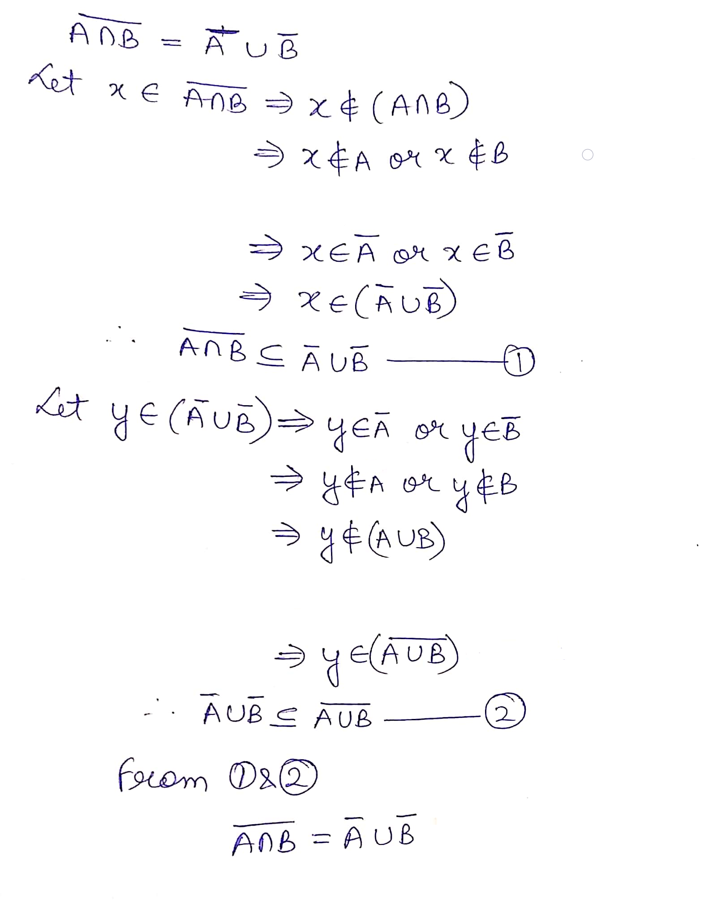
Example1 (By proving
subsets of each other)

Slide 7
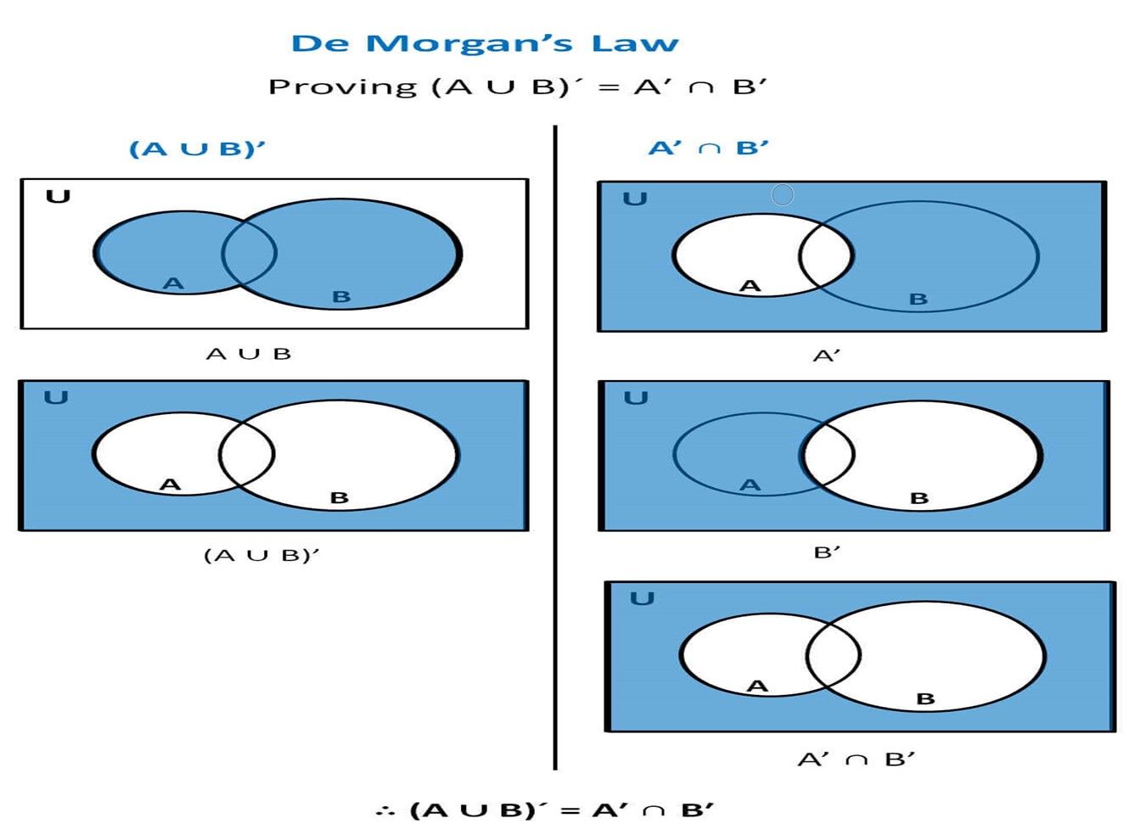
Example2 (By Venn Diagram)
Ref: https://www.teachoo.com/7038/1350/De-Morgans-Law/category/Complement-of-set/

Slide 8
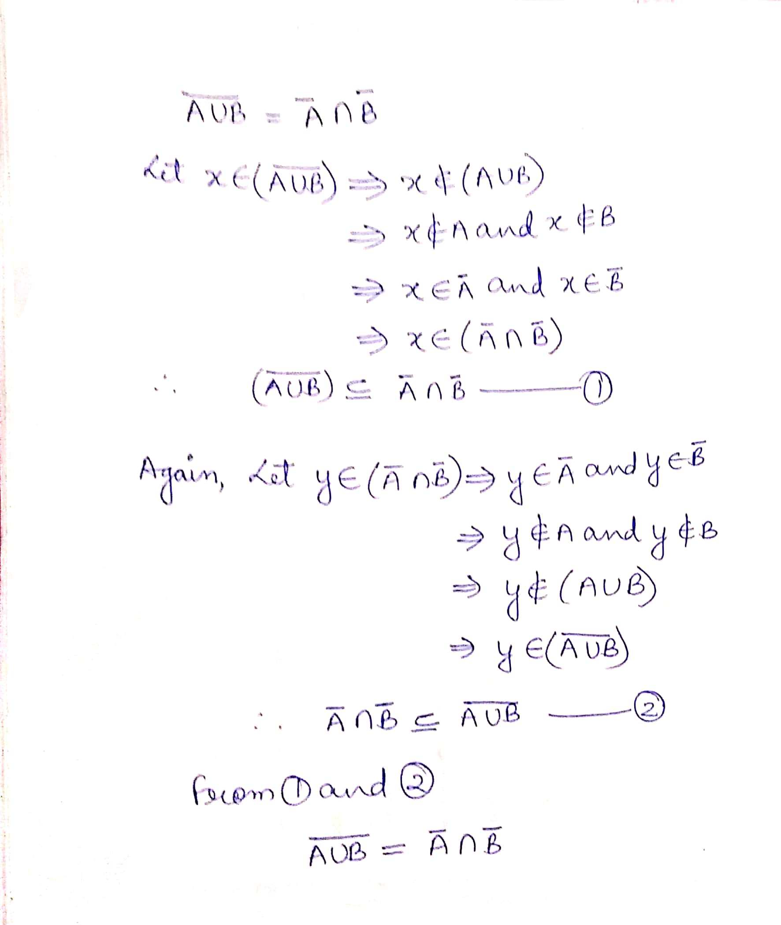
Example2 (By proving
subsets of each other)

Slide 9
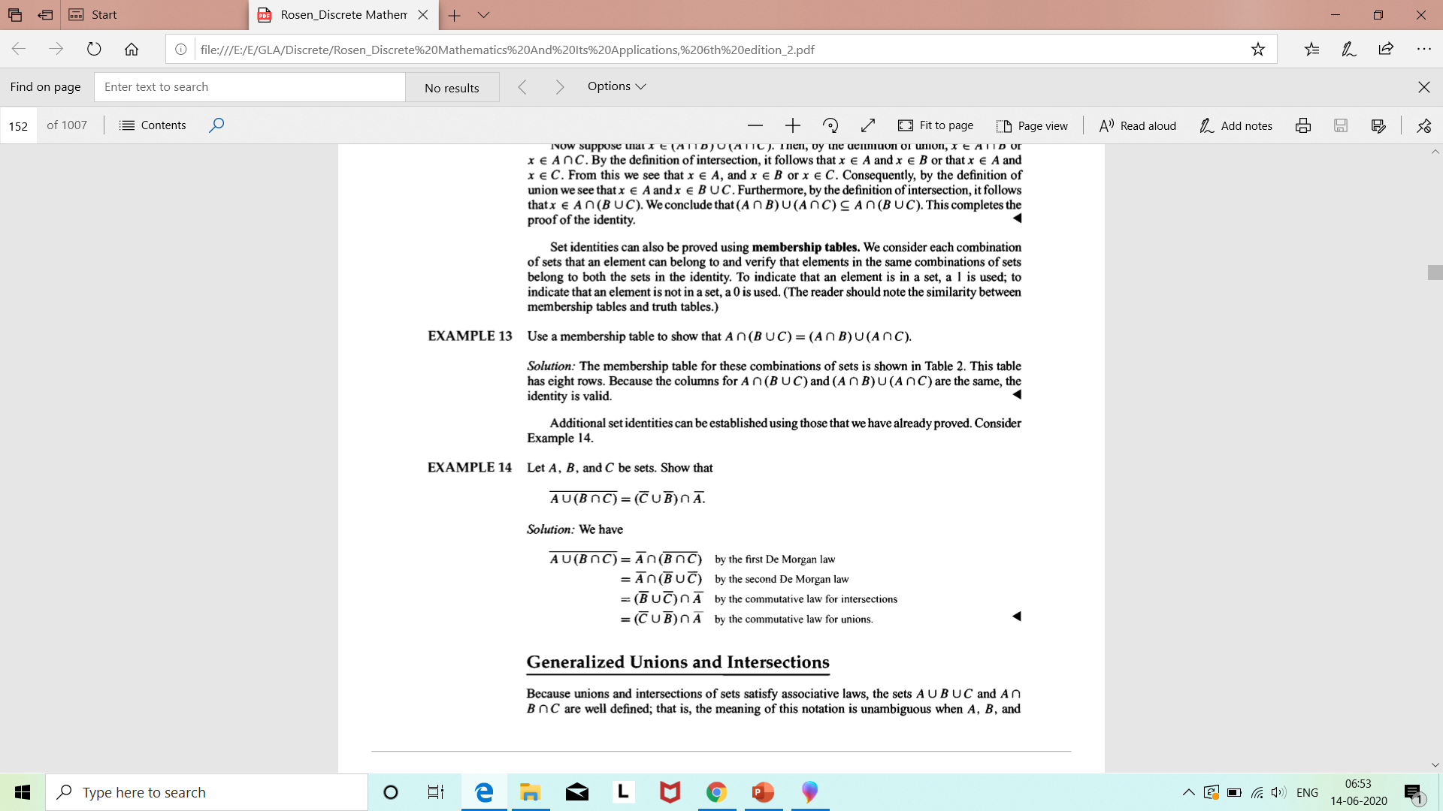
Example 3

Slide 10
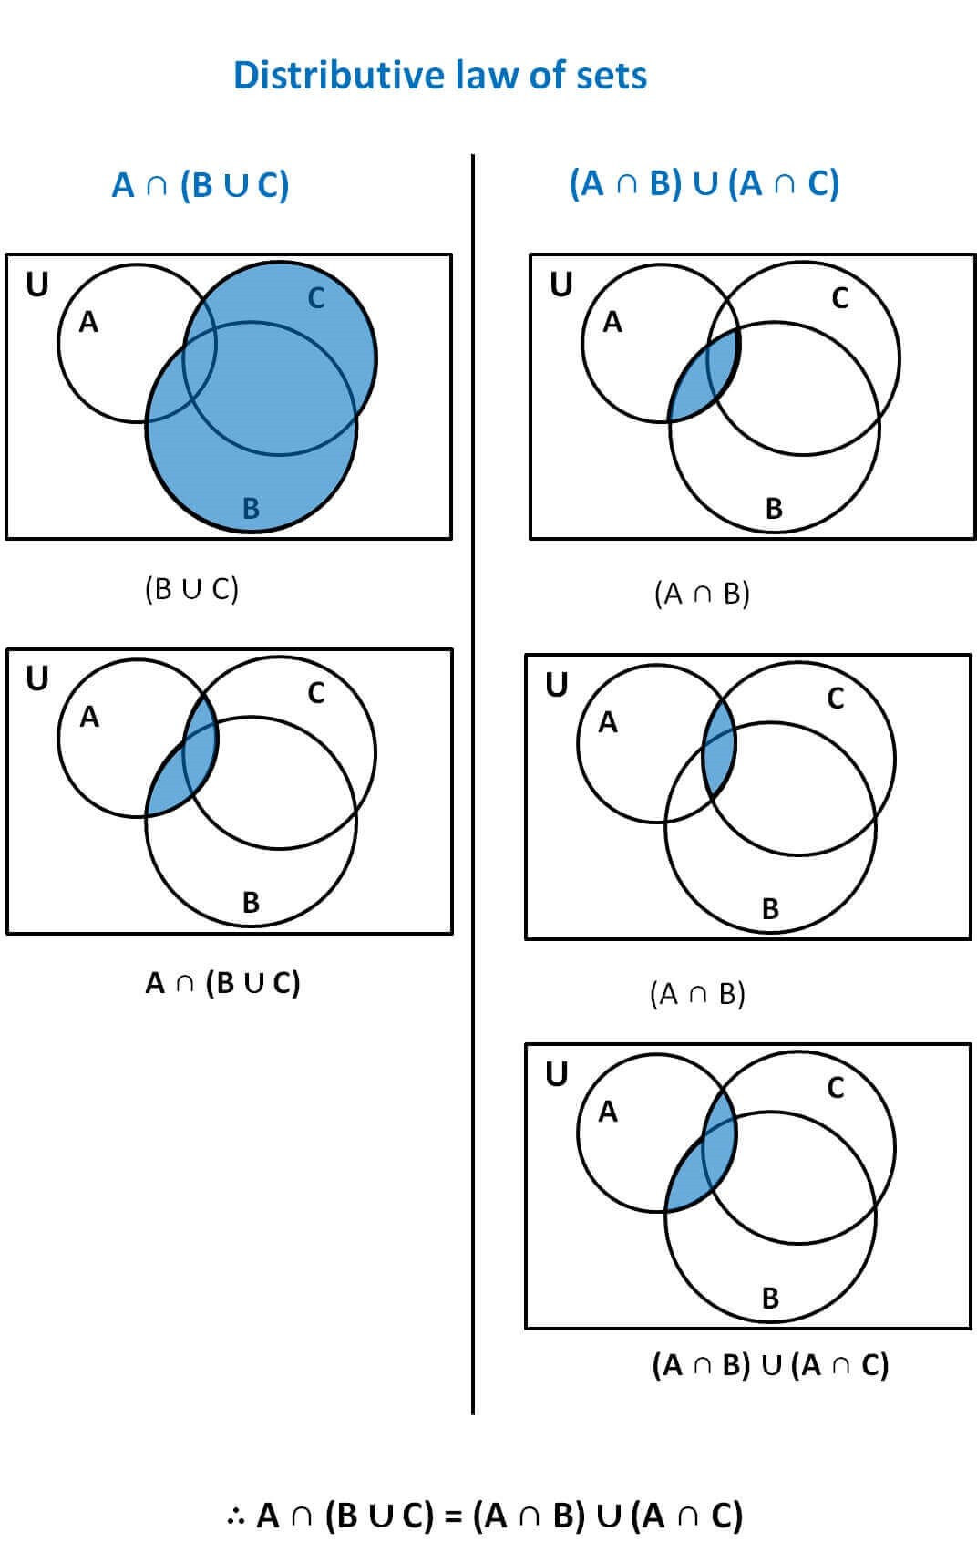
Example 4
Ref: https://www.teachoo.com/7035/1348/Proving-Distributive-law-of-sets-by-Venn-Diagram/category/Venn-Diagrams---Intersection/

Slide 11
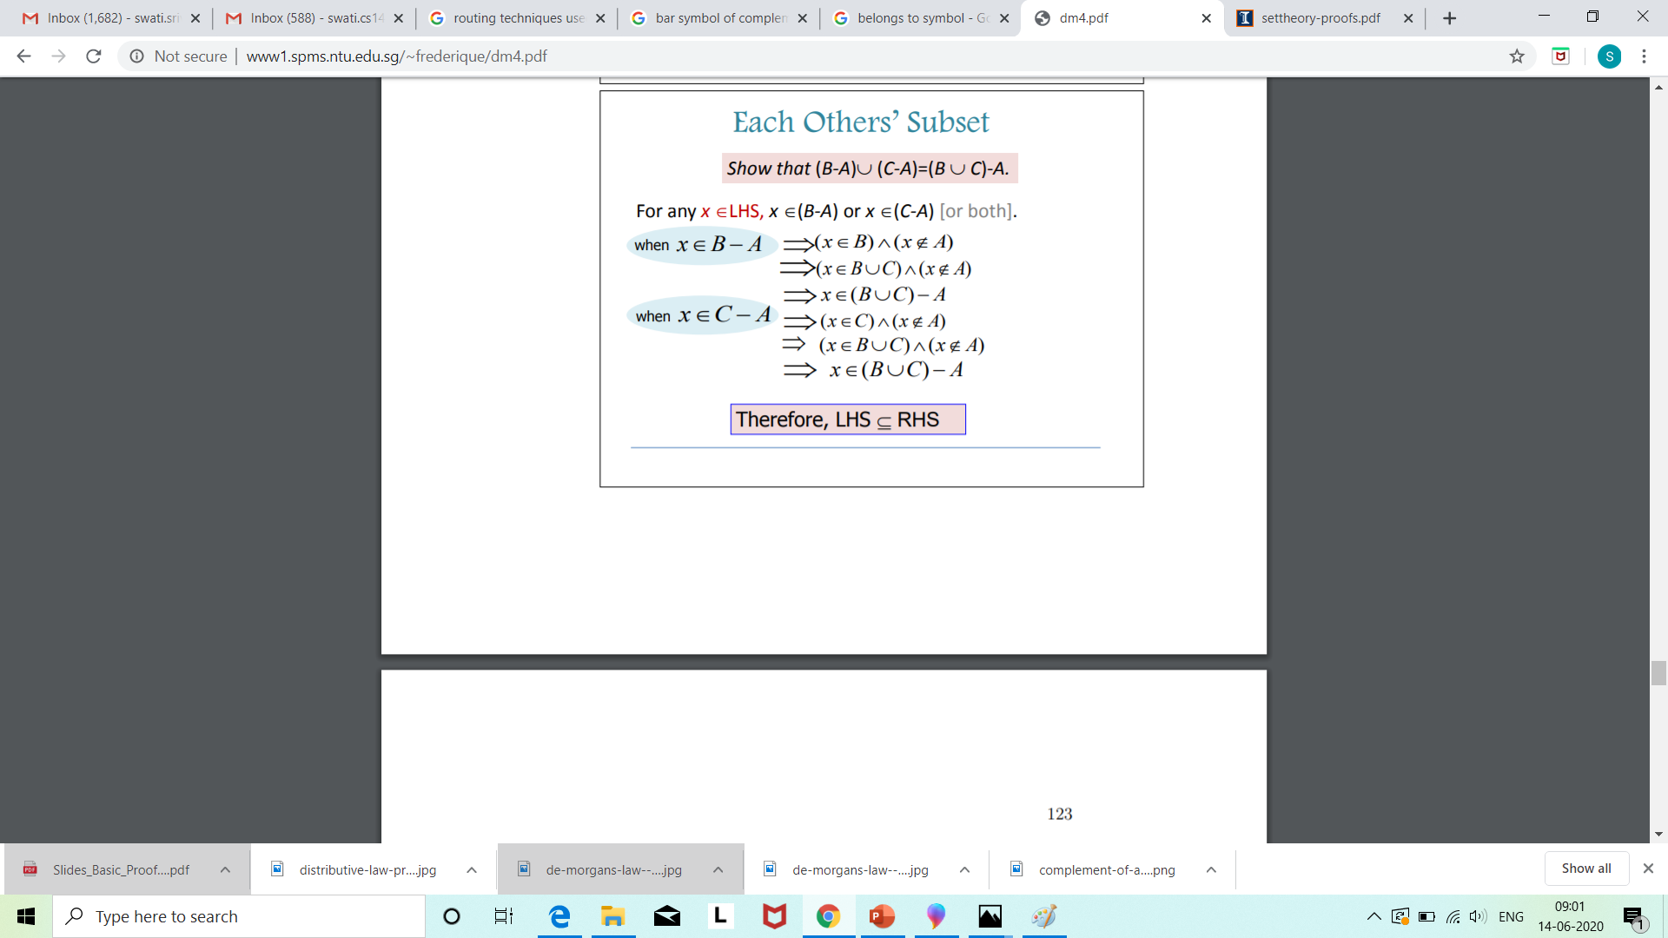
Example 5
Contd..

Slide 12
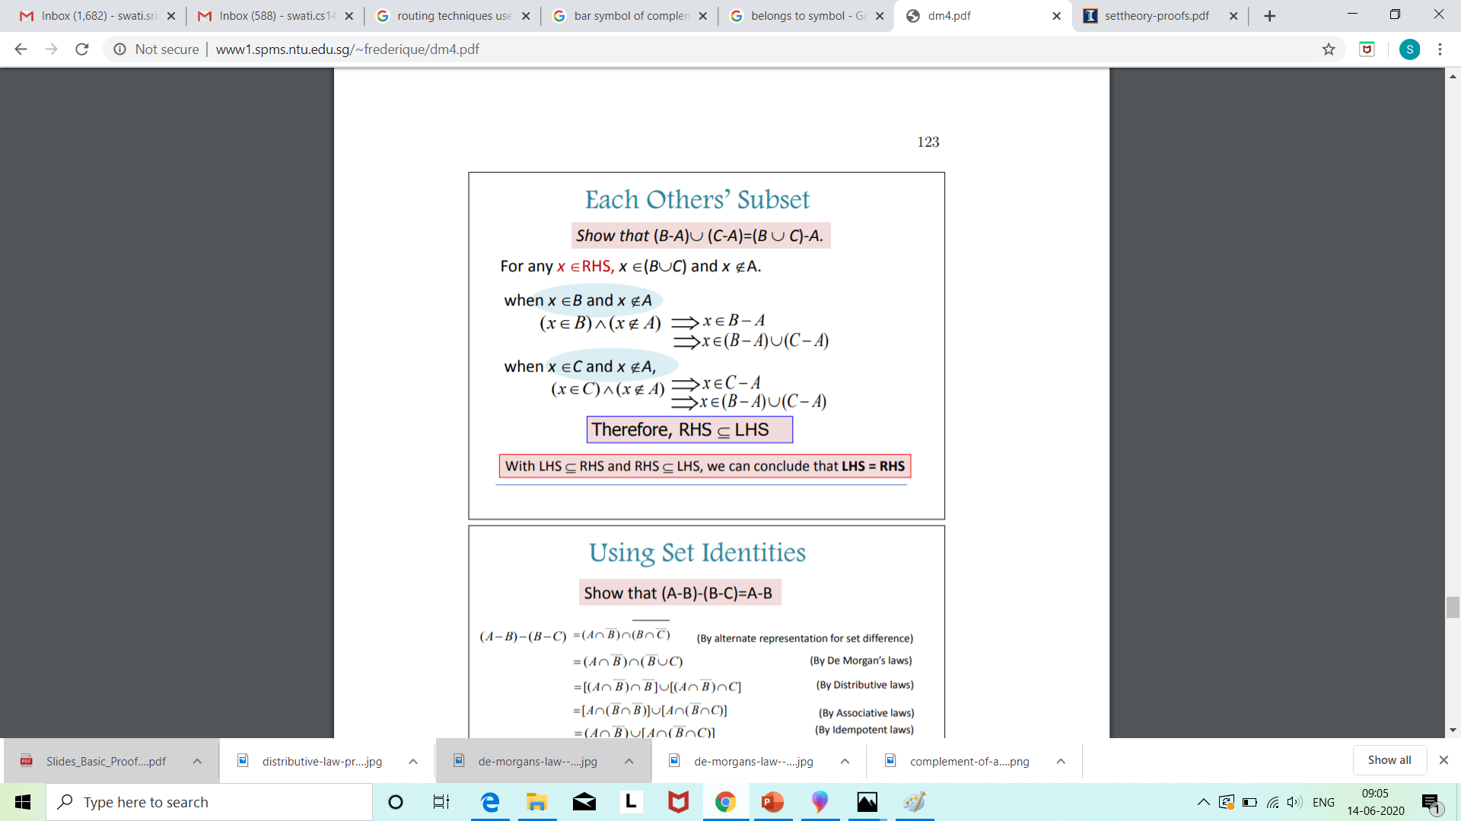
Ref: http://www1.spms.ntu.edu.sg/~frederique/dm4.pdf

Slide 13
Example 6 Show that (A – B) ∩ (C – B) = (A ∩ C) – B
Let x ∈ (A – B) ∩ (C – B)
⇒ x ∈ (A – B) and x ∈ (C – B)
⇒ (x ∈ A and x ∉ B) and (x ∈ C and x ∉ B)
⇒ (x ∈ A and x ∈ C) and x ∉ B
⇒ (x ∈ A ∩ C) and x ∉ B
⇒ x ∈ ((A ∩ C) – B )
So, (A – B) ∩ (C – B) ⊆ (A ∩ C) – B ... (1)
Contd…

Slide 14
Now, conversely
Let y ∈ (A ∩ C) – B
⇒ y ∈ (A ∩ C) and y ∉ B
⇒ (y ∈ A and y ∈ C) and (y ∉ B)
⇒ (y ∈ A and y ∉ B) and (y ∈ C and y ∉ B)
⇒ y ∈ (A – B) and y ∈ (C – B)
⇒ y ∈ (A – B) ∩ (C – B)
So, (A ∩ C) – B ⊆(A – B) ∩ (C – B) ... (2)
From (1) and (2),
(A – B) ∩ (C – B) = (A ∩ C) – B

